Slide 1
Active and Collaborative Learning
Joan Zoellner, Course Program Specialist
The Charles A. Dana Center at the University of Texas at Austin
June 4, 2021

Slide 2
Active and Collaborative Learning
Chat waterfall
Question 1: What are the benefits to students when you incorporate active/collaborative learning in your classes?
Question 2: What are the barriers to incorporating active/collaborative learning in your classes?

Slide 3
Evidence of Effectiveness
Do we need more evidence about the effectiveness of active and collaborative teaching strategies and related efforts to foster student engagement in their own learning?
“The general literature on college teaching and learning as summarized by many authors, Pascarella & Terenzini (2005) and Kuh et al. (2005) prominently among them, provides clear research evidence that active and collaborative instructional strategies are more effective than traditional lecture and discussion across most if not all dimensions of student learning.”
Fairweather, J. (2008). Linking evidence and promising practices in science, technology, engineering, and mathematics (STEM) undergraduate education.

Slide 4
Benefits of Student Collaboration
People working on complex problems in groups, with thoughtful and appropriate scaffolding, can often reach a deeper and more lasting understanding than can people working independently.
Groups can often arrive at better solutions by working collaboratively than can individuals working alone.
Collaboration is not a simple sharing of knowledge from more skilled to less skilled students. Explaining is an opportunity to learn. All who participate actively benefit.

Slide 5
Students need to engage in minds-on work to develop their conceptual understanding. There is evidence of improved student learning through:
  modeling-based courses,
  the use of clickers,
  Inquiry-Based Learning,
  active hands-on learning,
  and small group projects.
These all fall under the umbrella of active and collaborative learning strategies. Incorporating some of these strategies into your corequisite courses can help increase student retention and success.

Slide 6
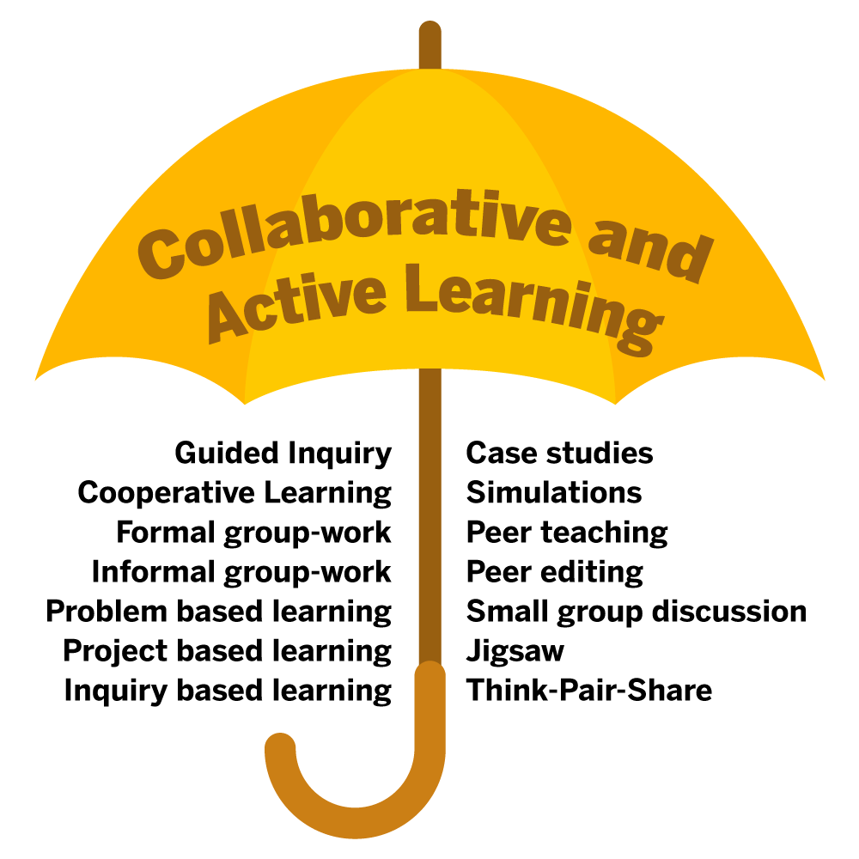

Slide 7
What does Active Learning Sound Like?
When students discuss mathematics with others, they:
  Clarify their own thinking.
  Articulate ideas to others who can extend the reasoning or point out misconceptions.
  Consider different ways of thinking about or solving a problem.
  Explain strategies used and justify solutions offered.
  Compare solution strategies for accuracy, utility, and efficiency.
  Relate to previous problems and topics to make connections.
  Practice and develop their ability to use correct notation and terminology to talk about mathematics.

Slide 8
Supporting Collaboration
  Students are not born with project management, time management, conflict resolution, and communication skills required for high performance teamwork.
  Oakley, Felder, Brent, and Elhaji (2004)
  Simply putting students in groups to work on assignments is not a sufficient condition for obtaining [the benefits of group work]…Instructors must take steps to assure that the groups develop attributes associate with high performing teams.

Slide 9
Key Considerations
Some key considerations to ensure that group work results in effective collaboration:
  Setting and refining the culture
  Assessment
  The task

Slide 10
Setting and Refining the Culture
Students need to understand why they are asked to collaborate.
Students need support to develop skills over time.
Collaboration should be introduced early and intentionally scaffolded throughout the course.
An initial activity should be strategically designed to introduce collaboration and to enable students to experience early success.

Slide 11
Key Considerations
Some key considerations to ensure that group work results in effective collaboration:
  Setting and refining the culture
  Assessment
  The task

Slide 12
Formative Assessment
“Formative assessment is used to inform students and teachers of students’ needs in order to improve mastery of the material, rather than penalize or rank students.”
Pamela Burdman,
The Mathematics of Opportunity: Rethinking the Role of Math in Educational Equity, Just Equations, November 2018, https://justequations.org/resource/the-mathematics-of-opportunity-report/
To put it another way: Formative assessment allows us to meet our students where they are and move them mathematically closer to the learning goals of a given unit of instruction.

Slide 13
Ways of Demonstrating Understanding
Students can display their understanding of a problem or concept in a variety of ways:
  Verbally – discussing with the teacher or with their peers, helping others understand, oral exam
  Illustratively – drawing a diagram or picture to model the situation
  Symbolically – using mathematical symbols or notation to communicate the answer or justification
  Comparatively – comparing the scenario to a similar one to which the lessons learned can be extended

Slide 14
Key Considerations
Some key considerations to ensure that group work results in effective collaboration:
  Setting and refining the culture
  Assessment
  The task

Slide 15
An Example of an Active and Collaborative Activity: Concept Check
  A combination of the formative assessment strategy of Voting/Clicker Questions and the Think-Pair-Share protocol
  A quick way to identify student familiarity with a concept, understanding, and misconceptions
  Can be used at the beginning, middle, or end of instruction of a concept

Slide 16
Concept Check – Online Demo
Which of the following contains, on average, the least caffeine?
A cup of coffee
A shot of espresso
A cup of green tea
A cup of black tea
https://padlet.com/joanzoellner/ConceptCheck
Notes:
https://padlet.com/joanzoellner/ConceptCheck

Slide 17
Concept Check – Process
Establish the rules for participation.
Ask students to vote.
  This will look different in an online or a F2F setting.
Ask students to discuss their answers with their classmates and make the case for their answer.
  This can either be breakout groups or a Padlet or other anonymous discussion forum online, or elbow partners in person.
Ask students to vote again.
Ask for volunteers to explain why their answer is correct.

Slide 18
Writing Concept Checks
  Use and/or modify multiple choice questions from the book.
  Pick wrong answers that correspond to common misconceptions.
  Voting question libraries for math classes are available at: http://mathquest.carroll.edu/

Slide 19
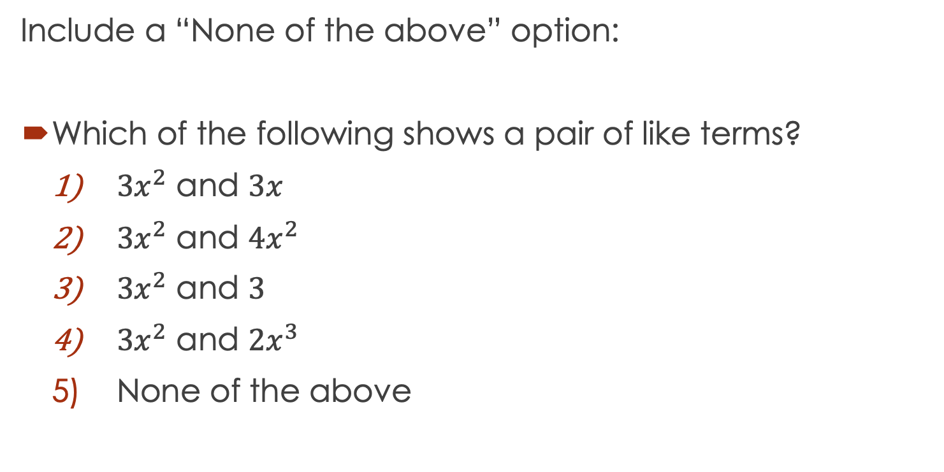
Concept Check Modifications
Include a “None of the above” option:
  Which of the following shows a pair of like terms?
  $3x^{2}$ and $3x$
  $3x^{2}$ and $4x^{2}$
  $3x^{2}$ and $3$
  $3x^{2}$ and $2x^{3}$
  None of the above

Slide 20
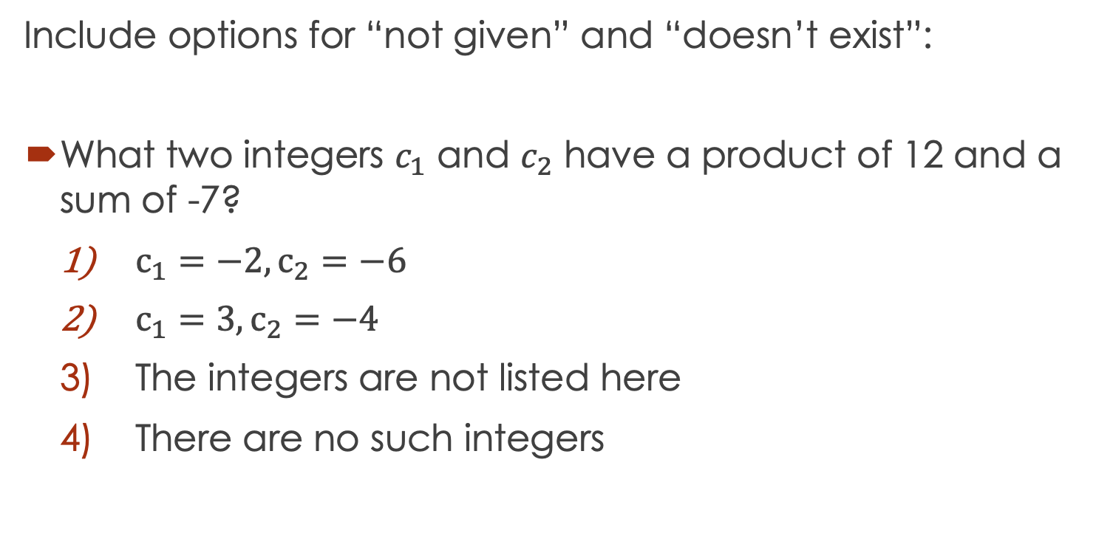
Concept Check Modifications
Include options for “not given” and “doesn’t exist”:
  What two integers $c_{1}$ and $c_{2}$ have a product of 12 and a sum of -7?
  $c_{1}=−2,c_{2}=−6$
  $c_{1}=3,c_{2}=−4$
  The integers are not listed here
  There are no such integers

Slide 21
Concept Check Modifications
Use a True/False question:
  All quadratic functions have at least one x-intercept.
  True, and I am very confident.
  True, but I am not very confident.
  False, but I am not very confident.
  False, and I am very confident.

Slide 22
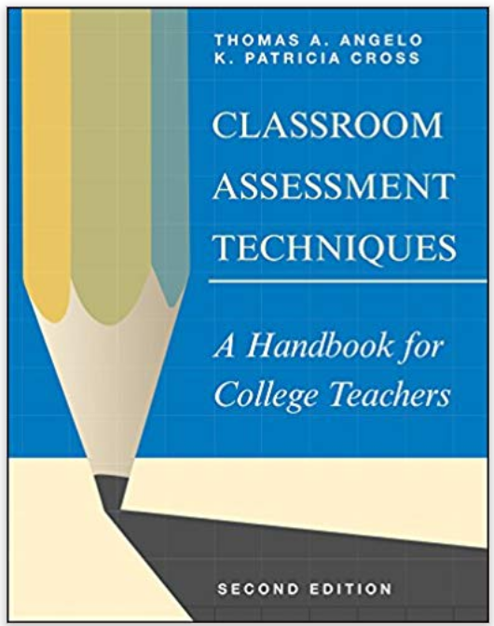
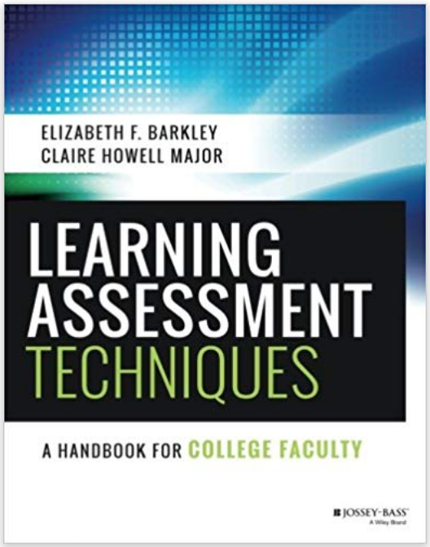
Other Resources

Slide 23
Questions?

Slide 24
Contact Information
Joan Zoellner
Email: joan.zoellner@austin.utexas.edu
Twitter: @joan_zoellner

