Slide 1
Active Learning Techniques in Math
Victoria Dominguez Dean of Mathematics and Business Former Mathematics Faculty Citrus College, Glendora, CA

Slide 2
Active Learning Techniques in Math
Why Active Learning?
Set the Stage - Beginning of the term
Don’t let the mid-term slump happen!
Strong to the finish line…
Engagement in Zoom (COVID-19 pandemic)
Thank you and Questions

Slide 3
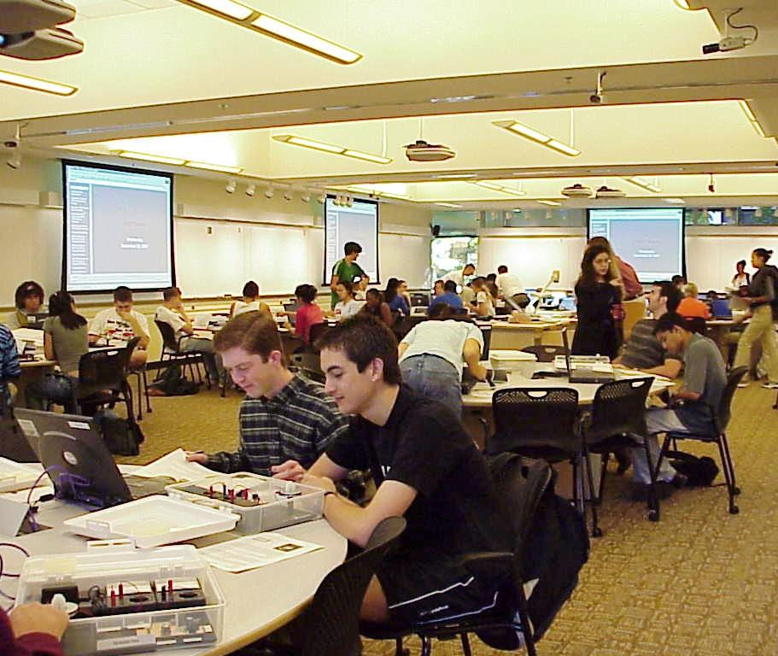
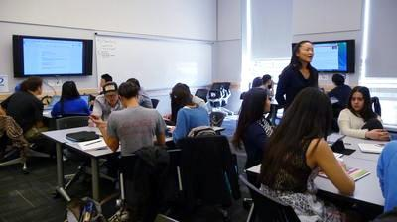
Active Learning Classrooms
SCALE-UP: Student-Centered Active Learning Environment with Upside-Down Pedagogies (NCSU)
TEAL: Technology-Enabled Active Learning (MIT)
TILE: Spaces to Transform, Interact, Learn, Engage (UIOWA)

Slide 4
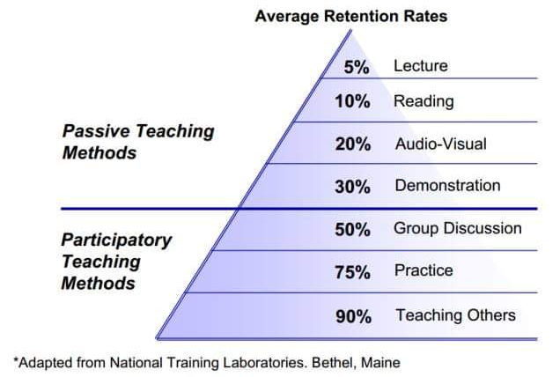
Student-Centered Learning Opportunities
Notes:
S

Slide 5
Why the Active Learning Classroom?
Create independent learners who are
Comfortable taking on the classwork
Ready to fail and rebound
More engaged
Learn how to be more assertive

Slide 6
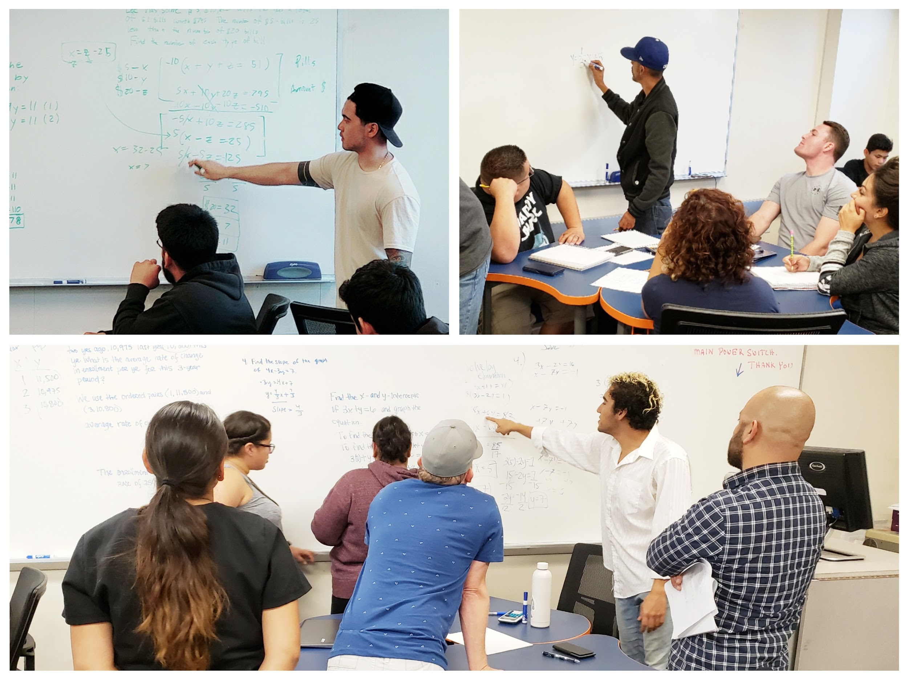
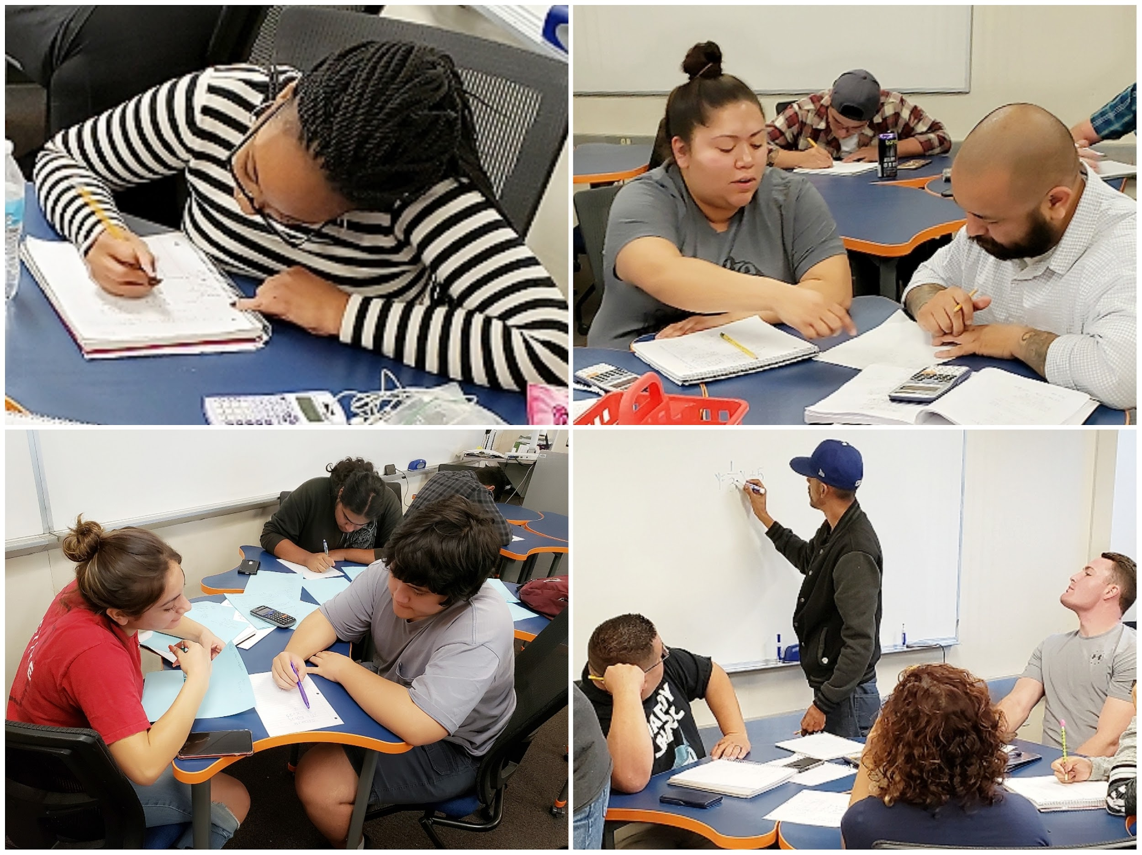
Leadership Potential

Slide 7
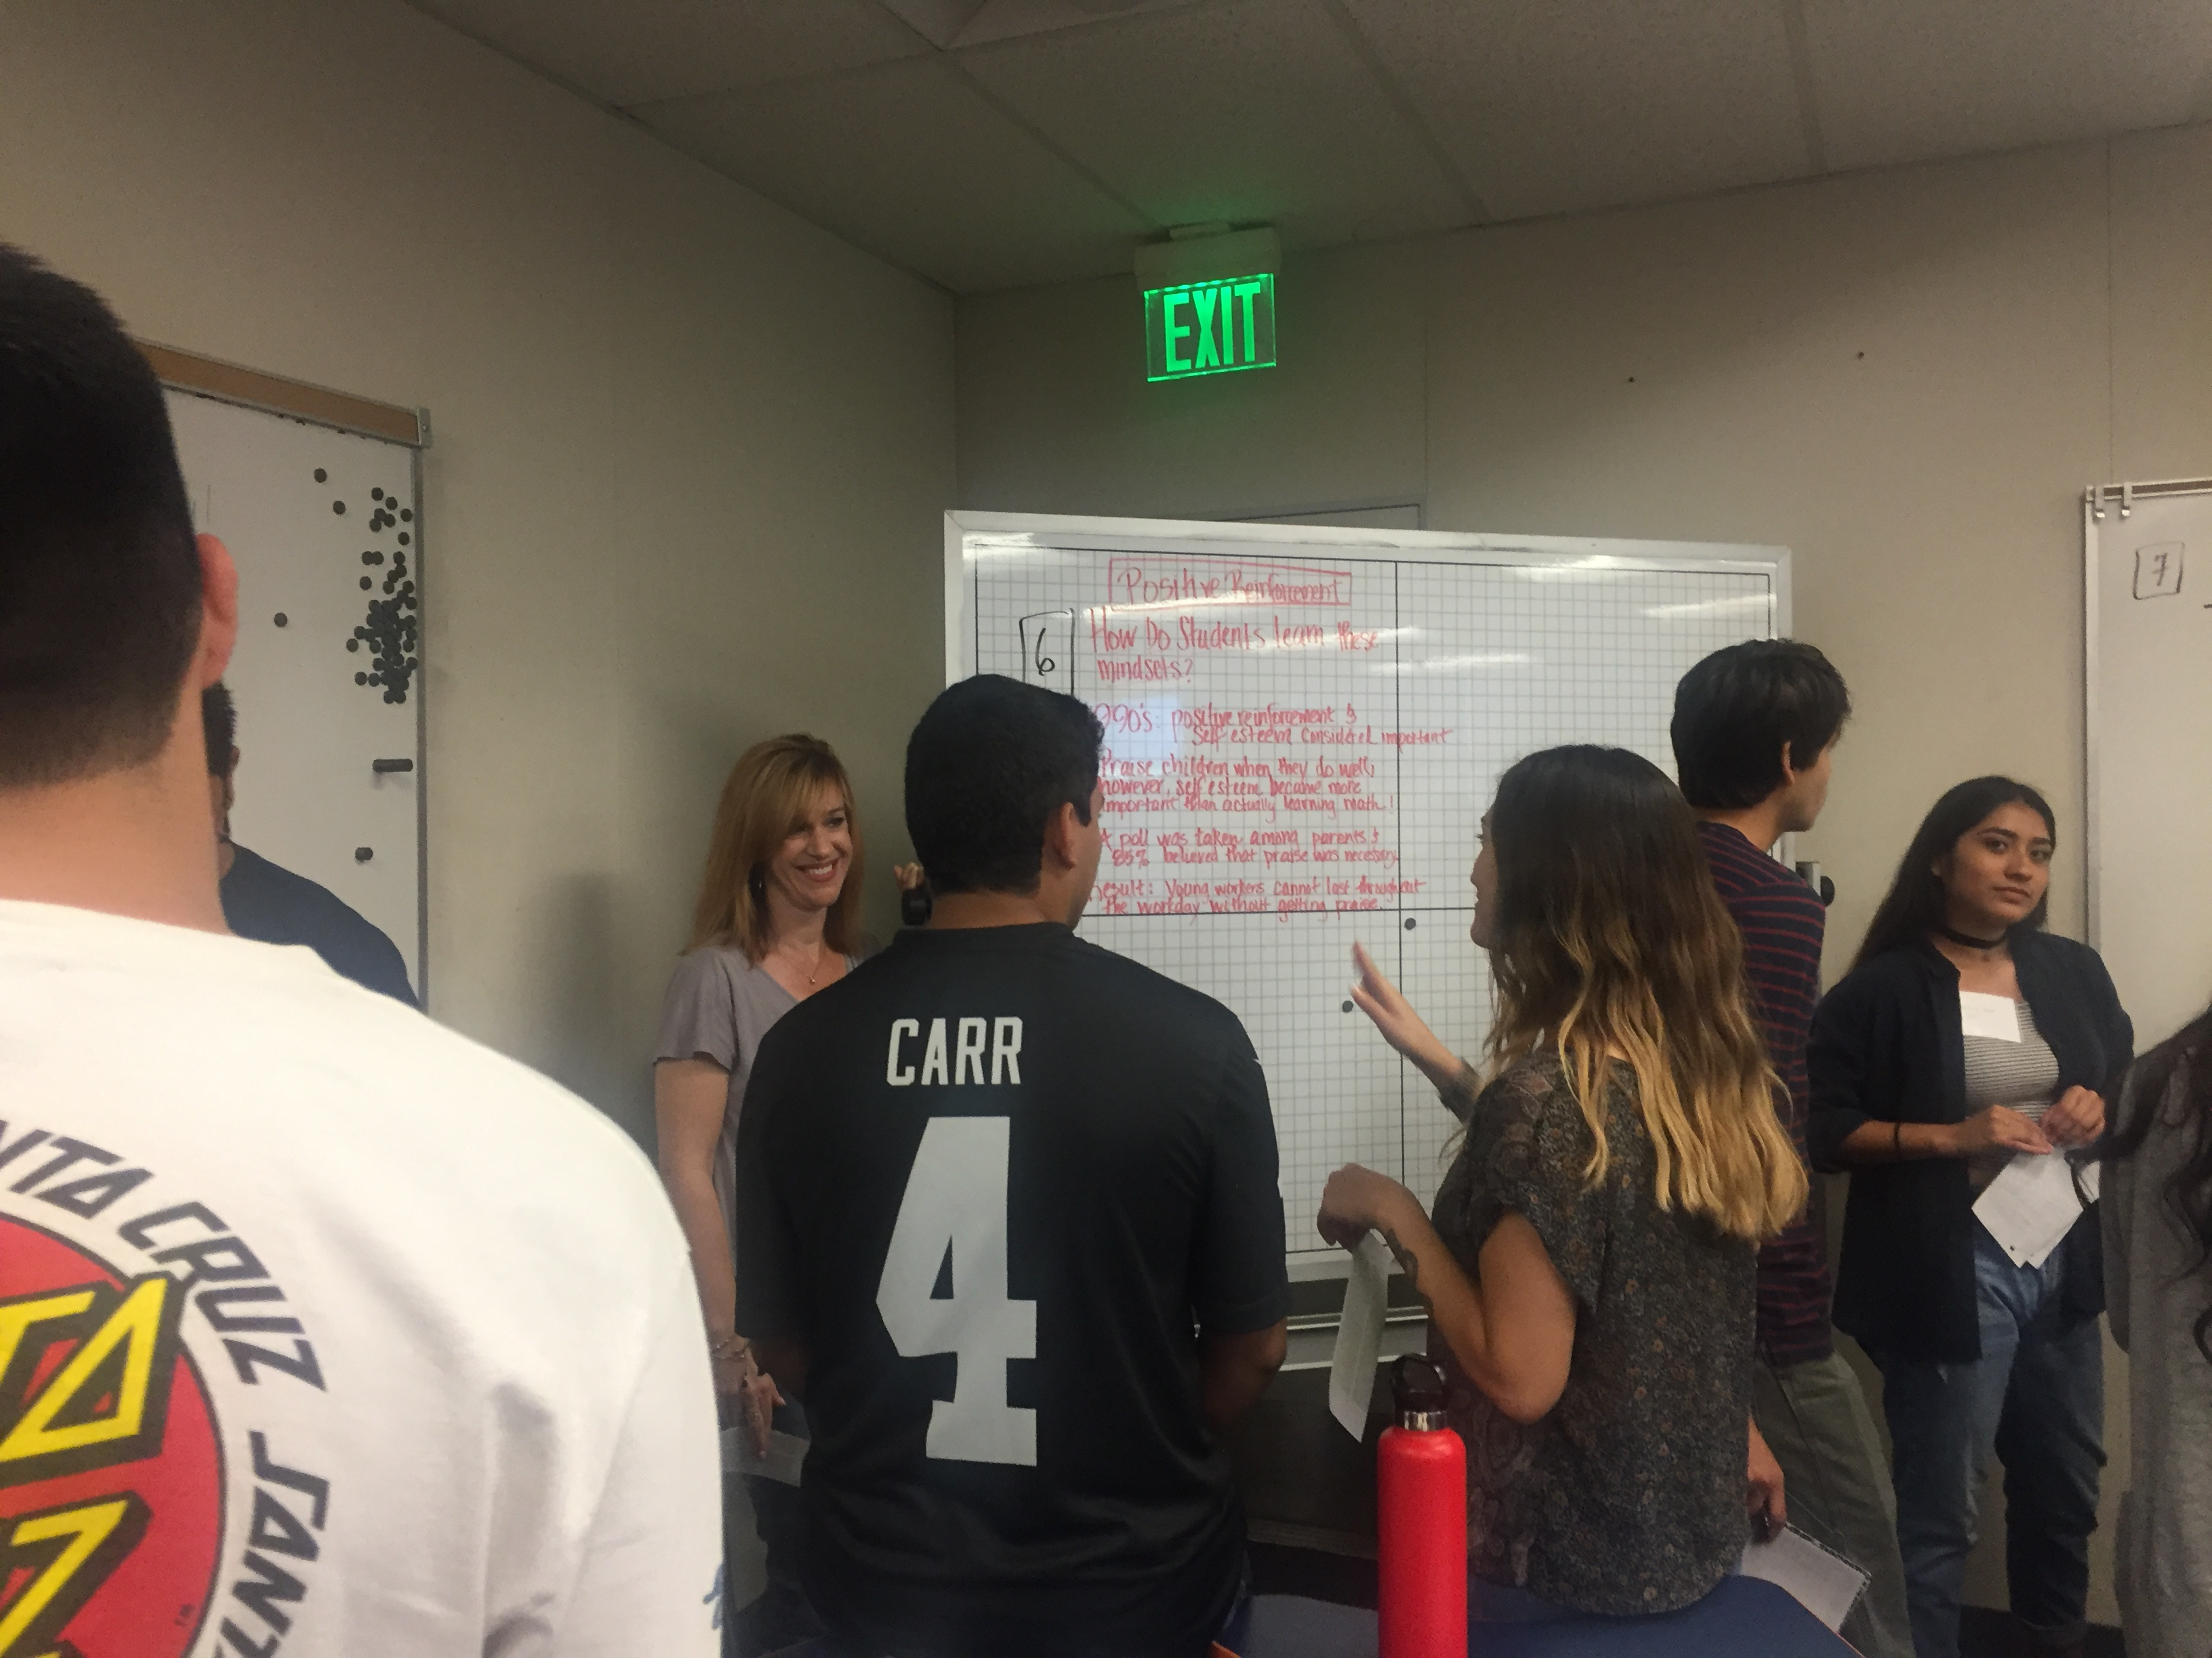
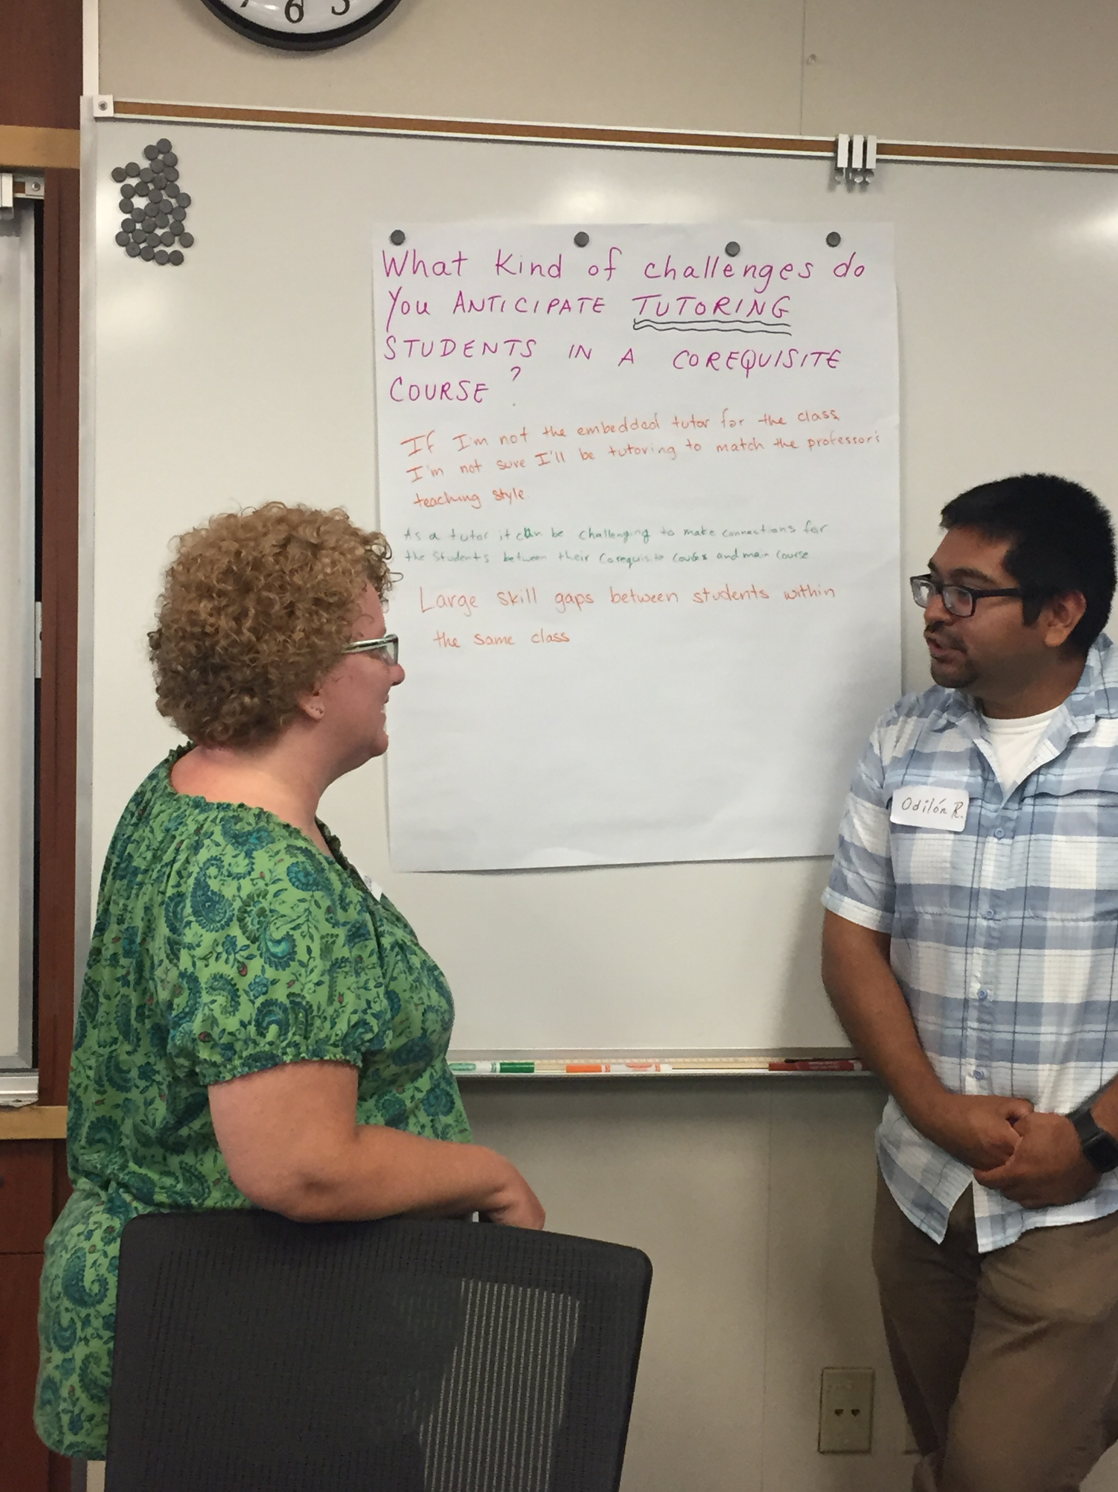
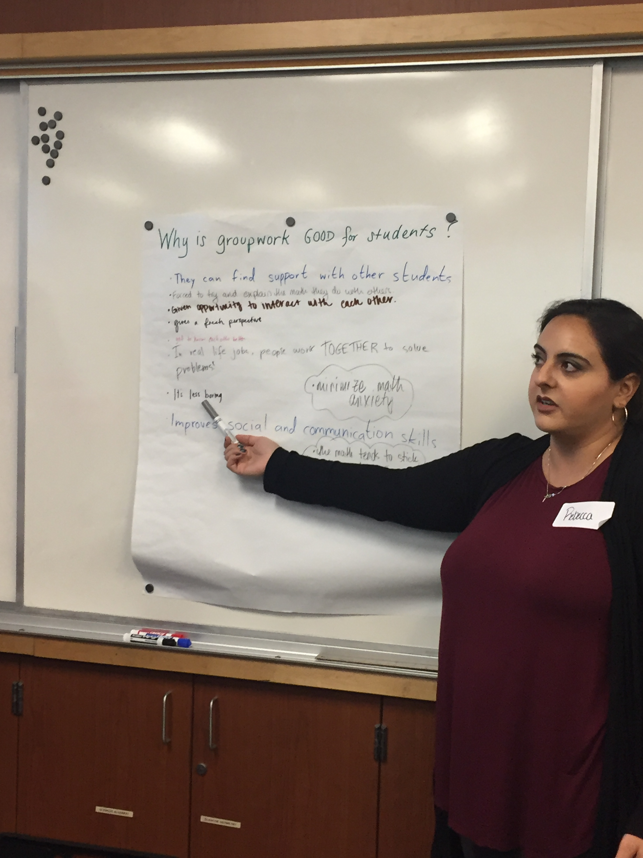
Day 1: Student Leaders Emerge

Slide 8
Active Learning Techniques in Math
Why Active Learning?
Set the Stage - Beginning of the term
Don’t let the mid-term slump happen!
Strong to the finish line…
Engagement in Zoom (COVID-19 pandemic)
Thank you and Questions

Slide 9
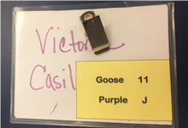
Building an Active Supportive Classroom Community
Group Cards
Encourage and expect group interactions from Day 1
Small groups of 3-4
Large Group (entire class)
Wean them off asking you!
The power of the group

Slide 10
Syllabus – Page 1 Statement
I believe we all have the capacity to do college-level NAME THAT CLASS HERE and that we can tap into that capacity as a team of teachers and learners who are responsible for each other’s success in the class. I am very happy to work with you this semester, to demystify math and be part of your journey toward achieving your educational goals. Together through our good hard work and persistent, sustained efforts, we can all be successful, and reap the rewards of education. **
** Attributed to Terrie Nichols, Cuyamaca College

Slide 11
Building an Active Supportive Classroom Community Get to know you cards
Side 1
First and last name
What do they want to be called?
Side 2 – Answers to four questions
What is your major?
What was the last math class taken, and grade earned?
What are 2 things you will do to support your learning in this class?
What are 2 things I can do to support your learning in this class?

Slide 12
Introducing Active Learning To Your Students
Start out with low-stakes responses (Week 1)
Thumbs up/down
Green/Red/Yellow index cards
Graduate to more verbal responses (Weeks 2-3)
Use index cards to call on students
Call on all students once, then start over
Gets them used to answering you in a low-stress environment
Use Canvas to group students together
Notes:
Canvas groups

Slide 13
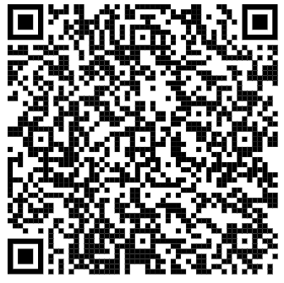
Introducing Active Learning To Your Students (continued)
Open-ended class analysis project (Weeks 1-3)
Use a gallery walk to disseminate the results
Brainology – Carol Dweck
Groups of 3 read an assigned paragraph
Roles: Scribe, Questioner, Speaker
The Scribe takes group notes
The Questioner thinks of questions to ask the group
The Speaker will summarize and answer questions on behalf of the group

Slide 14
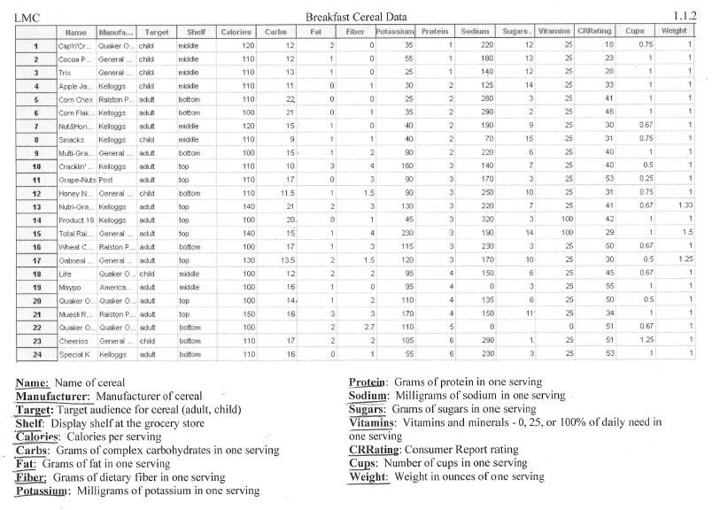
Introducing Active Learning To Your Students (continued)
Math - Cereal data (Statistics) from Myra Snell (CAP*)
* CAP = The California Acceleration Project is a faculty-led professional development network that supports California’s 116 Community Colleges to transform remediation to increase student completion and equity.
Notes:
Inquiry-based learning with a topic that everyone can connect with

Slide 15
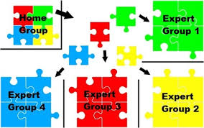
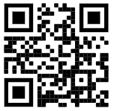
Introducing Active Learning To Your Students (continued)
Use a Jigsaw* to help students:
Learn Statistics terminology/Speak the discipline language
Practice a set of problems after a lesson
Teach others
Value all student contributions (everyone is an “expert”)
* https://www.jigsaw.org/#steps
Notes:
Teaching others is the best way for students to learn
I use a Jigsaw once every semester in every class I taught. It takes a lot of time, but really helps forge the student bond.

Slide 16
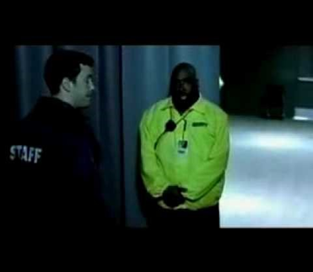
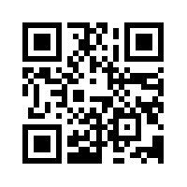
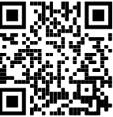
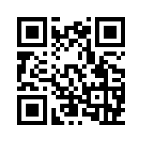
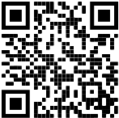
Affective Domain Activities – Week 1
Michael Jordan Failure Video | https://www.youtube.com/watch?v=45mMioJ5szc
Michael Jordan “Maybe It’s My Fault” Video | https://www.youtube.com/watch?v=9zSVu76AX3I
Broken Escalator Video | https://www.youtube.com/watch?v=VrSUe_m19FY&t=30s
Famous Failures Video | https://www.youtube.com/watch?v=zLYECIjmnQs&t=11s

Slide 17
Campus Scavenger Hunt (weeks 1-2)
Use Canvas groups
Groups upload to Canvas a .pdf of photos from campus locations (instructor office, health center, etc.)
1-2 weeks for completion
Adaptation for remote instruction: have students upload screenshots from the campus website

Slide 18
Educational Autobiography (week 2)
Writing assignment to help you learn more about your students
Good math experiences
Not so good math experiences
End on a high note – what are they looking forward to in your class?

Slide 19
Growth Mindset
Students have a very fixed mindset about learning mathematics
Quick Think-Pair-Share:
In your groups, talk about something that is hard for you to do (not math, something else).
Example: I have a hard time learning a language.
How does one overcome this problem?
Groups brainstorm their ideas on the whiteboards
Adaptation for Remote Teaching – use Google Jamboard
REMIND them often about checking their mindset

Slide 20
Productive Struggle
Students need to experience the struggle and understand it’s part of learning
Let Learners Struggle assignment – in-class or homework
Mention “Productive Struggle” often during the course

Slide 21
Active Learning Techniques in Math
Why Active Learning?
Set the Stage - Beginning of the term
Don’t let the mid-term slump happen!
Strong to the finish line…
Engagement in Zoom (COVID-19 pandemic)
Thank you and Questions

Slide 22
Middle 4 weeks…
Frequent self-reflection opportunities
Help students gauge where they are in the class,
A reset to convince hearts and minds that what they are doing isn’t working
One-minute paper
Exam reflection
Exam ReDo
Short student survey

Slide 23
Middle 4 weeks… (continued)
Video/Reading Quizzes at the beginning of class
5-minute, 3-4 question group quiz
Helps to reinforce the importance of completing the assigned work (watch videos, reading the textbook)
Low-stakes formative assessment

Slide 24
Active Learning Techniques in Math
Why Active Learning?
Set the Stage - Beginning of the term
Don’t let the mid-term slump happen!
Strong to the finish line…
Engagement in Zoom (COVID-19 pandemic)
Thank you and Questions

Slide 25
Finish strong at the end of the semester…
Think-Pair-Share-Square exam study guide reviews
Exam reviews at the white board (include a gallery walk)
Encourage study groups outside of class
Canvas groups?
Keep a zoom meeting always open so students can meet to study

Slide 26
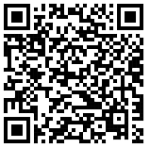
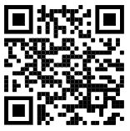
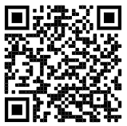
Active Engagement before the Final Exam
Gallery Walk: https://www.mudandinkteaching.org/new-blog/2016/8/18/best-practices-the-gallery-walk
Gallery Walk
Speed Dating
Final Exam Review Game
Lots of others
(Jennifer Gonzalez’s podcast/blog “The Cult of Pedagogy”
https://www.cultofpedagogy.com/speaking-listening-techniques/
From Fractad Fractopia Math Blog https://fractad.wordpress.com/tag/speed-dating/
Notes:
These techniques take time…plan so that you have the time to do at least one at the end of the semester
All information has been provided to Brandon to share with you!

Slide 27
Active Learning Techniques in Math
Why Active Learning?
Set the Stage - Beginning of the term
Don’t let the mid-term slump happen!
Strong to the finish line…
Engagement in Zoom (COVID-19 pandemic)
Thank you and Questions

Slide 28
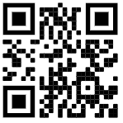
Ideas on how to increase student engagement during COVID-19
In the remote environment, check even more often for understanding
Use Google Jamboard to elicit responses
Less lecture – more groupwork in Zoom Breakout Rooms
Assign roles for each person
Whiteboard scribe, Explainer, Focuser/Timekeeper
Examples: the person with their birthday closest to today will be the…
How to use Google Jamboard video:
https://youtu.be/S9m4HCjOkcA

Slide 29
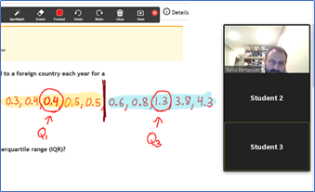
Hybrid Instruction Modality -
(50% online in zoom/50% self-directed)
Students Watch Lessons and Complete Assignments Before Class
Mini-Quizzes Beginning of Class
Class Time Used for Group Work and Activities
Embedded Tutor Helps Students By Moving From One Breakout Room to Next
Give Group Quizzes Using Breakout Rooms

Slide 30
Active Learning Techniques in Math
Why Active Learning?
Set the Stage - Beginning of the term
Don’t let the mid-term slump happen!
Strong to the finish line…
Engagement in Zoom (COVID-19 pandemic)
Thank you and Questions

Slide 31
Thank you –
it’s been a pleasure!
Questions?
See my classroom in action! https://www.youtube.com/watch?v=h0j3hAOijSk
Notes:
Doing this work feels difficult and uncertain at first, but becomes more comfortable as you make it your own.
Fall 2020-
Math 162 1
Math 062/162 3
Math 165 22
Math 065/165 21
Math 175 9
Math 075/175 9

