Slide 1
Notes:
Elizabeth

Slide 2
Welcome
CCA Intro
Understanding the Problem
Coreq 101
#CoreqWorks
Oregon Data
Notes:
Brandon

Slide 3
Meeting Dates
for Campus Implementation Teams
all meetings 9:00-12:00 PT
October 15
November 19
January 21
February 18
Notes:
Brandon

Slide 4
Complete College America
Mission
CCA is a bold national advocate for dramatically increasing college completion rates and closing institutional performance gaps by working with states, systems, institutions, and partners to scale highly effective structural reforms and promote policies that improve student success.
Notes:
Brandon

Slide 5
Complete College America
Mission
CCA is a bold national advocate for dramatically increasing college completion rates and closing institutional performance gaps by working with states, systems, institutions, and partners to scale highly effective structural reforms and promote policies that improve student success.
Notes:
Brandon

Slide 6
Complete College America
Vision
CCA envisions a nation where all students, regardless of race, ethnicity, socioeconomic status, or familial educational achievement, have equal opportunities to access and complete a college education or credential of value because postsecondary institutions, policy makers, and systems of higher education welcome, invest in, and support these students through and to an on-time completion.
Notes:
Brandon

Slide 7
Complete College America
Vision
CCA envisions a nation where all students, regardless of race, ethnicity, socioeconomic status, or familial educational achievement, have equal opportunities to access and complete a college education or credential of value because postsecondary institutions, policy makers, and systems of higher education welcome, invest in, and support these students through and to an on-time completion.
Notes:
Brandon

Slide 8
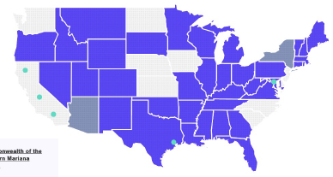
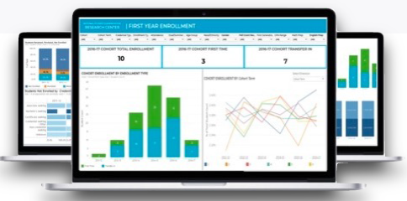
CCA has made our mark through:
Research & Insights
Alliance Engagement
Strategic Initiatives
Notes:
Brandon

Slide 9
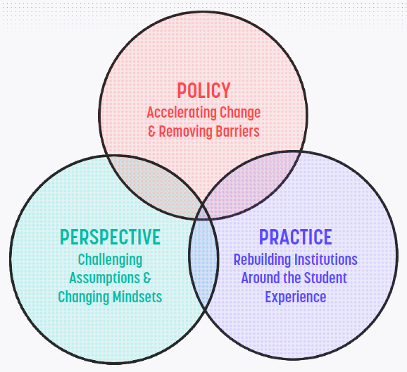
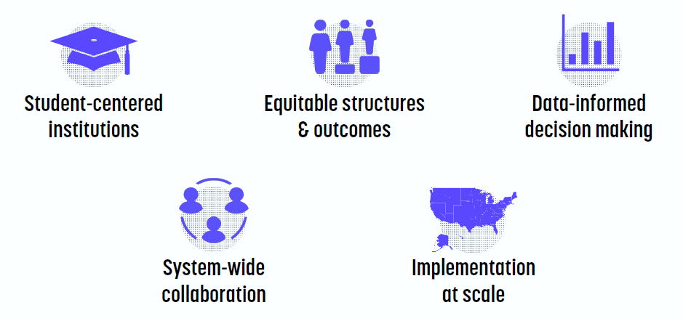
CCA Change Model and Our Values
Notes:
Brandon

Slide 10
CCA Strategies
Notes:
Brandon

Slide 11
www.completecollege.org
Join Us!!
Notes:
Brandon

Slide 12
Strong Start Oregon
Launch Meeting
Math Faculty Design Teams
Campus Implementation Teams
Scaling
Corequisite Support
for Math
CCA + Content Experts
Notes:
Brandon

Slide 13
Notes:
Heidi
Multiple Semesters, Progressive Curriculum, Math Skills Building

Slide 14
Notes:
Heidi
Single Semester with aligned content + just-in-time teaching
Student Supports: non-academic support, academic skill building, growth mindset, active learning, affective connection
Coreq is right thing to do – structural removal of barriers

Slide 15
You are not the problem.
The system is the problem.
You are the solution.
Notes:
Heidi
Flawed structure and system.
Process of attrition across multiple semesters - either not passing or not returning.

Slide 16
Notes:
Heidi
Another way to see the impact

Slide 17
How one college improved student success through coreq support at scale
Notes:
Heidi
CCD study – a real example of impact

Slide 18
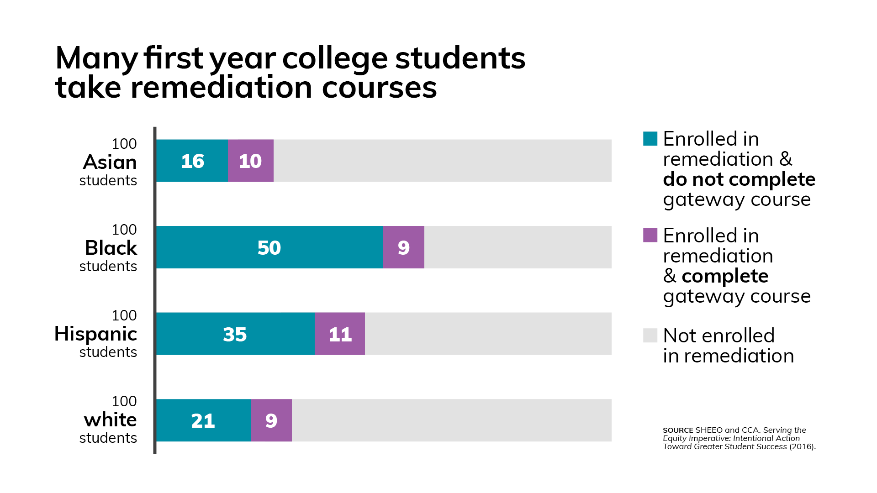
Notes:
Heidi
Deeply embedded inequities disproportionately harm Blacks, Latinx students
more often assigned to dev ed and do not get through.
Coreq as an equity strategy toward increased college completion

Slide 19
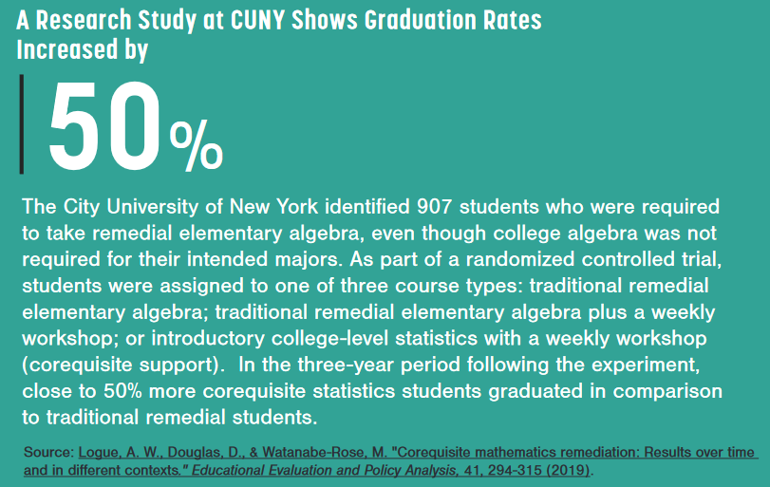
“The corequisite group not only demonstrated significantly higher quantitative course pass rates but also success in many other disciplines, as well as significantly higher graduation rates. …corequisite mathematics remediation can result in greater student success than is obtained with traditional remediation.”
Notes:
Heidi
Long term impact

Slide 20
Shifting the Institutional Narrative
Migrating away from “Is this student college ready?”
Adopting “Is our college student ready?”
Notes:
Heidi
Introducing and implementing critical education research to the folks who need it classroom faculty, advisors, tutoring staff.

Slide 21
College-level Course Same depth, rigor, and expectations
Corequisite Course More flexibility in structure and pacing Addresses student needs in college-level course Mini-lectures, small group work, inquiry-based problems, individual attention Metacognition, math literacy, academic & non-academic success strategies | Pedagogical Approach Fill in gaps in background knowledge Reviews material previously learned Preview upcoming topics for the college-level course Support the college-level course instruction Supplemental resources and materials
Notes:
Loretta

Slide 22
Foundational Considerations
Students, regardless of race, ethnicity, socioeconomic status, or familial educational achievement, have equal opportunities to access and complete college.
Colleges welcome, invest in, and support students through on-time completion.
Students can be successful with the right institutional models of support.
Moving beyond a deficit model focused on what academic skills students lack, a growth mindset recognizes student potential for success, particularly for those who are disproportionally placed into a remedial courses.
Notes:
Loretta

Slide 23
Foundational Considerations
Access to remediation is not access to college. Enrollment in gateway courses and corequisite support should be the default placement for students.
Students needing additional support should be provided assistance as a corequisite, not a prerequisite, within the context of the gateway college‐level course.
Completion of a set of gateway courses is a critical measure of success toward college completion and should be completed in the first year of college.
The content in required gateway courses should align with a student’s academic program of choice (math pathways).
Notes:
Loretta

Slide 24
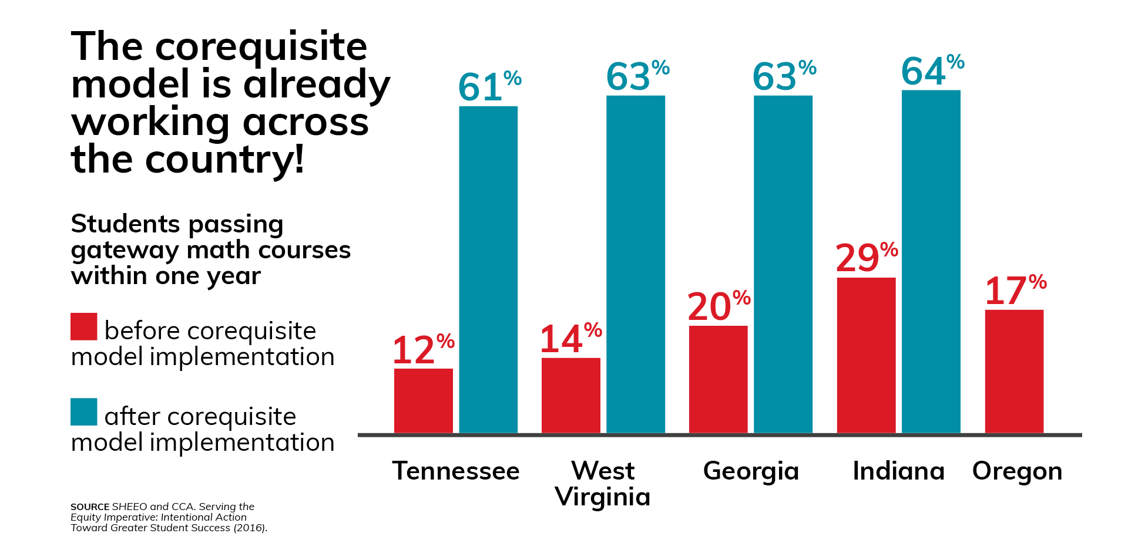
Notes:
Loretta
Data is clear → Coreq WORKS!

Slide 25
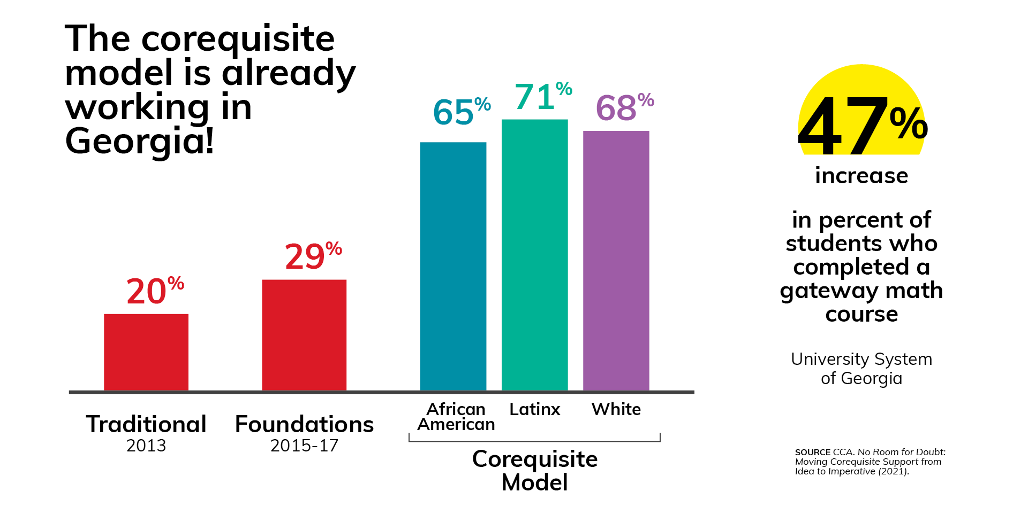
The University System of Georgia used corequisite support to eliminate achievement gaps
Notes:
Loretta
Data is clear → Coreq WORKS!

Slide 26
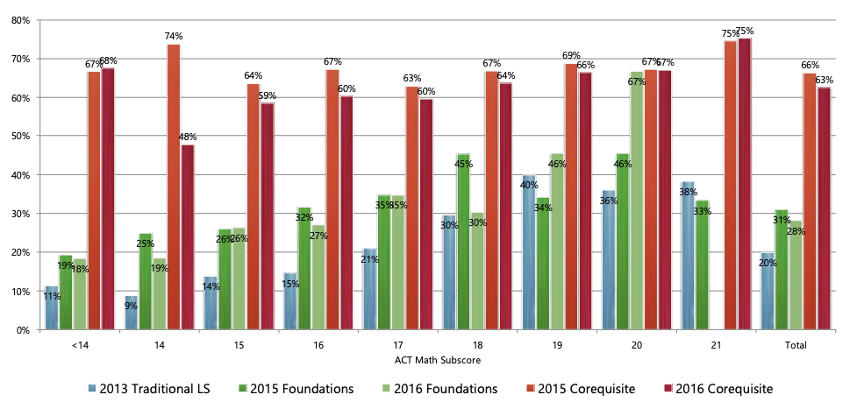
University System of Georgia
Comparison of Success in Gateway Mathematics Classes
http://completegeorgia.org/sites/default/files/resources/Denley_CoRequisite_Academy_Mathematics_0.pdf
Success at every level of academic preparation
http://completegeorgia.org/sites/default/files/resources/Denley_CoRequisite_Academy_Mathematics_0.pdf
Notes:
Loretta
Across all levels of academic preparation

Slide 27
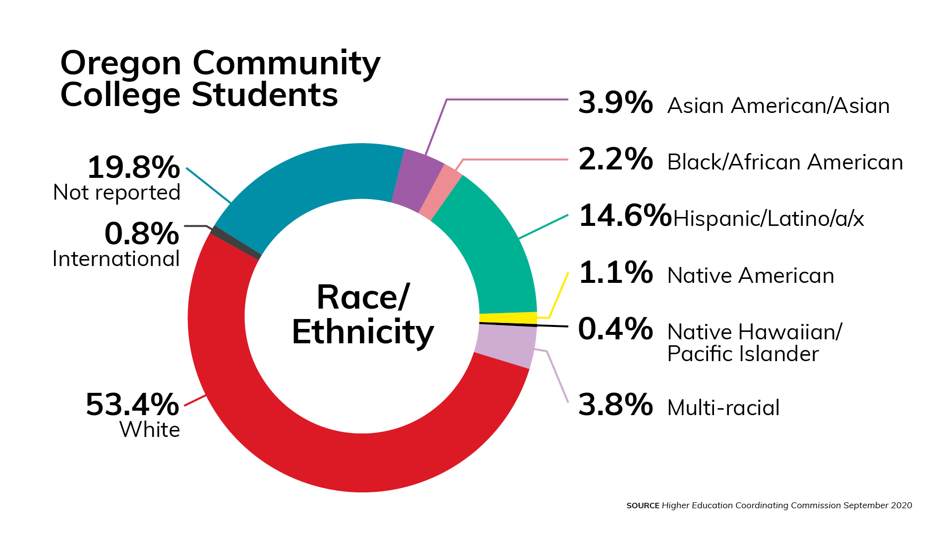
The Oregon Landscape
Notes:
Elizabeth

Slide 28
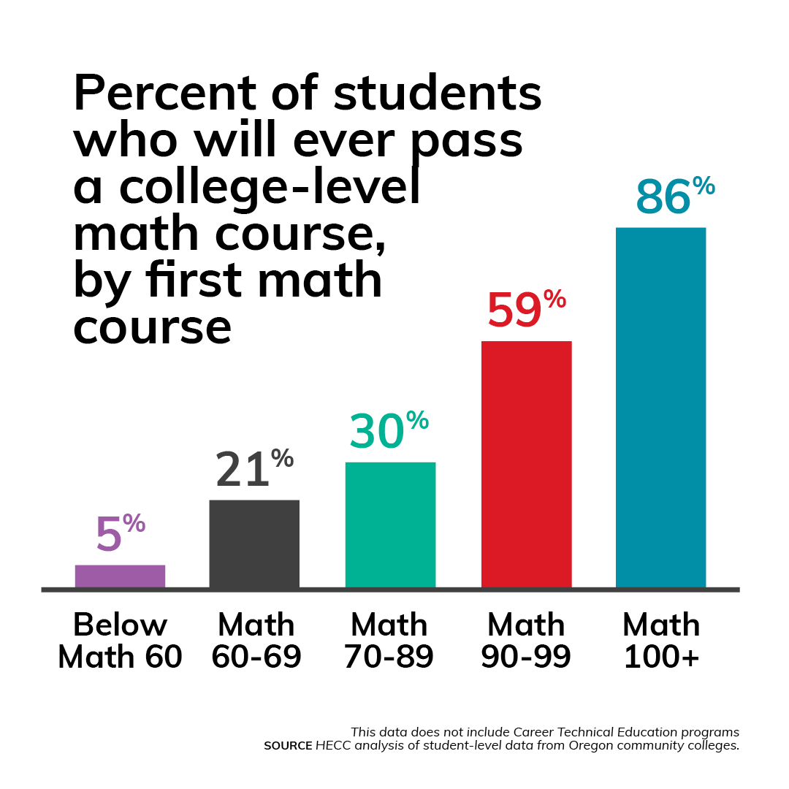
Percent of students
who will ever pass a college-level math course,
by first math course
Notes:
Elizabeth

Slide 29
Percent of students
who earn a post-secondary credential within six years, by first math course
Type of credential
Started in developmental math
Associate degree
Certificate
Started in college-level math
Source: HECC analysis of student-level data from Oregon community colleges.
Notes:
Elizabeth
few students who start in developmental math ever earn a credential

Slide 30
Notes:
Elizabeth
few students who start in developmental math ever earn a credential

