Slide 1
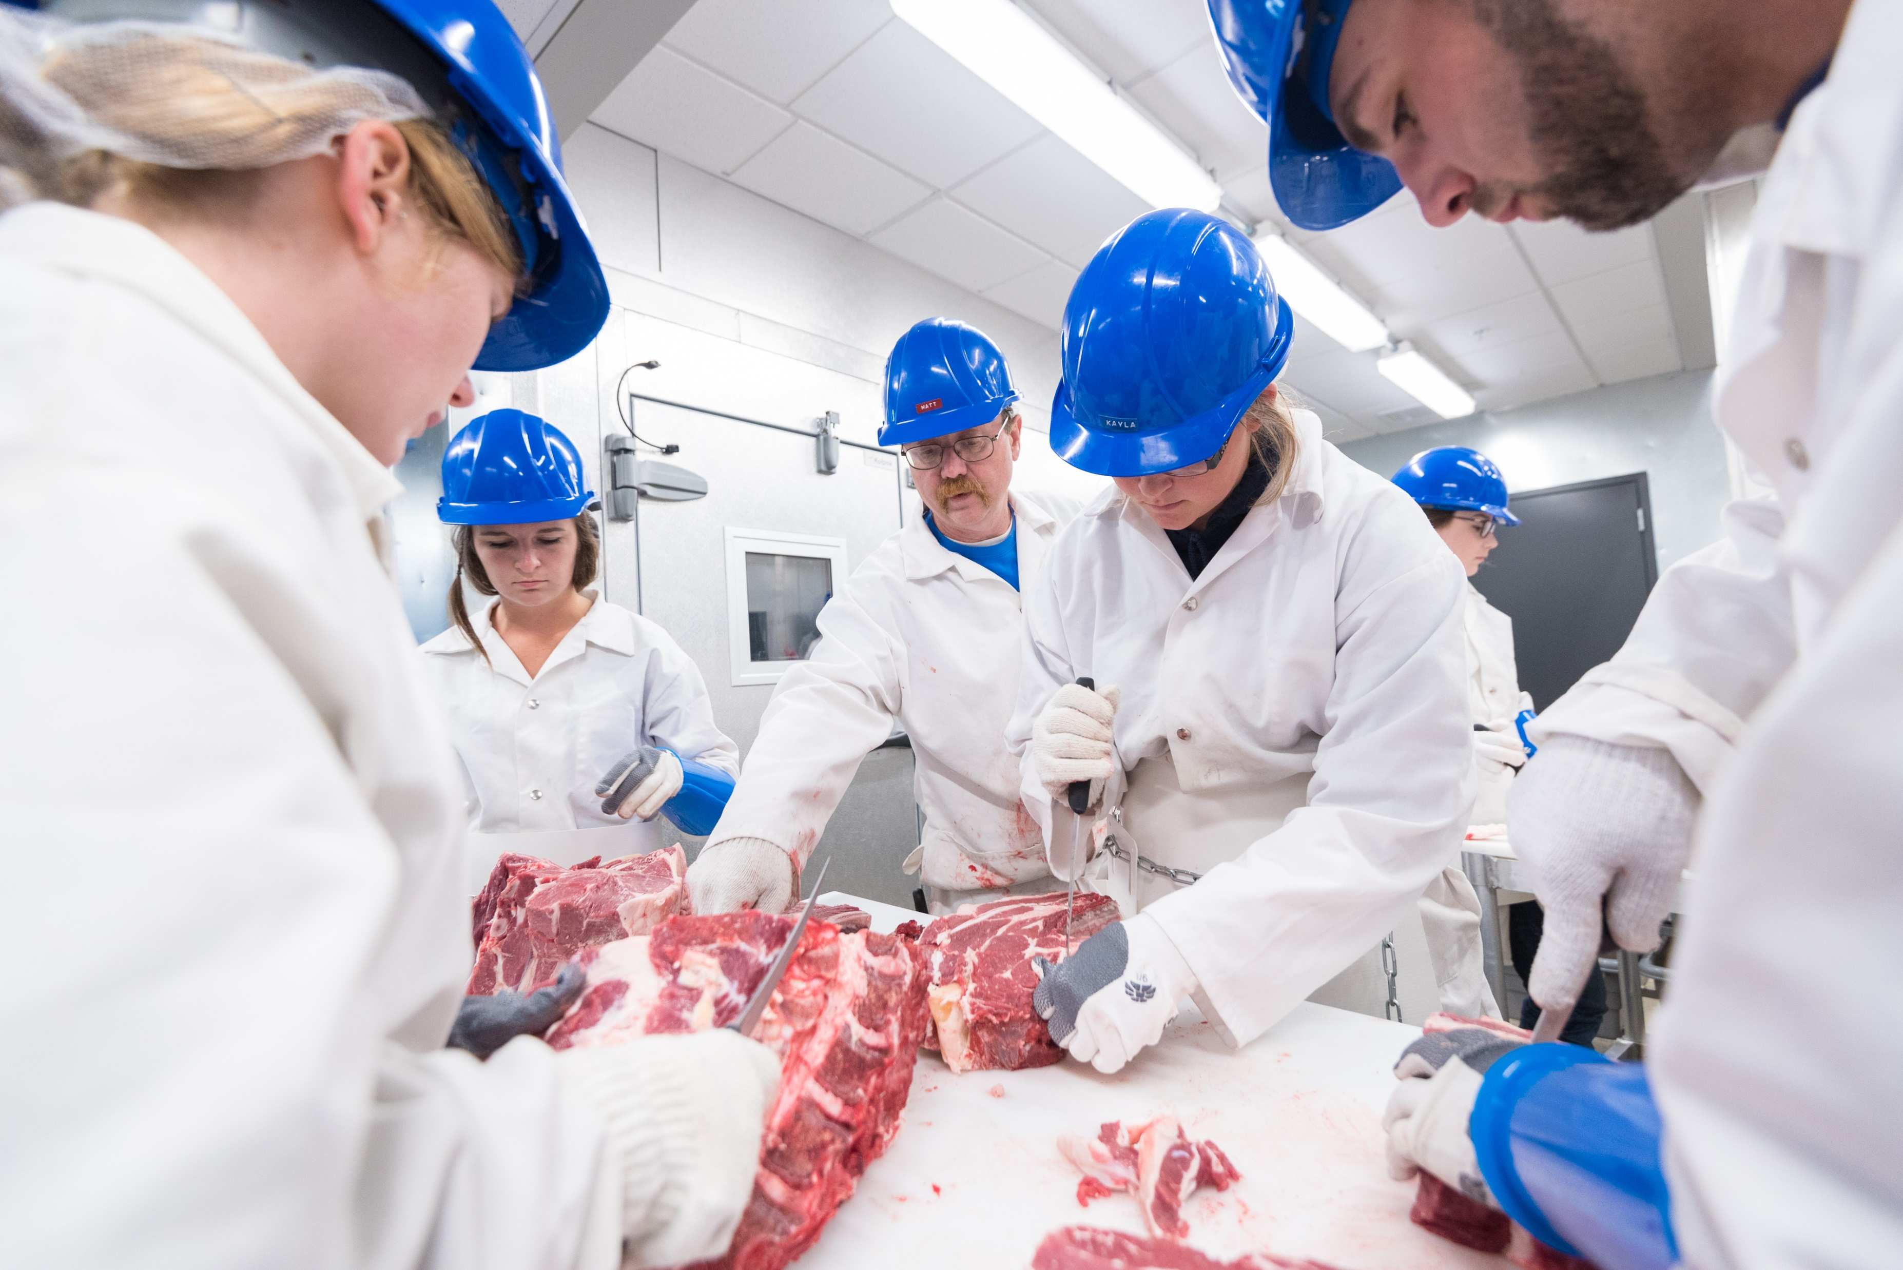
BLUE MOUNTAIN COMMUNITY COLLEGE
SCIENCE PROGRAM

Slide 3
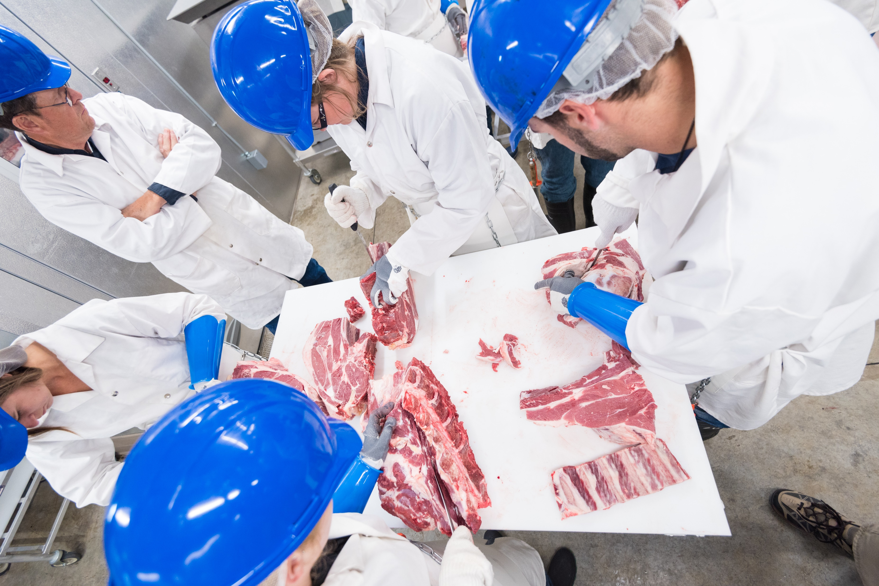
MEAT SCIENCE LAB
The purpose of the Blue Mountain Community College Meat Science Lab is to introduce our Production Livestock Students to the area of meat science. We currently offer two classes in this area of study.
ANS 261 - Intro to Meat Science
ANS 262- Intro to Processed Meats
Work-Study Program that employs 4 students

Slide 4
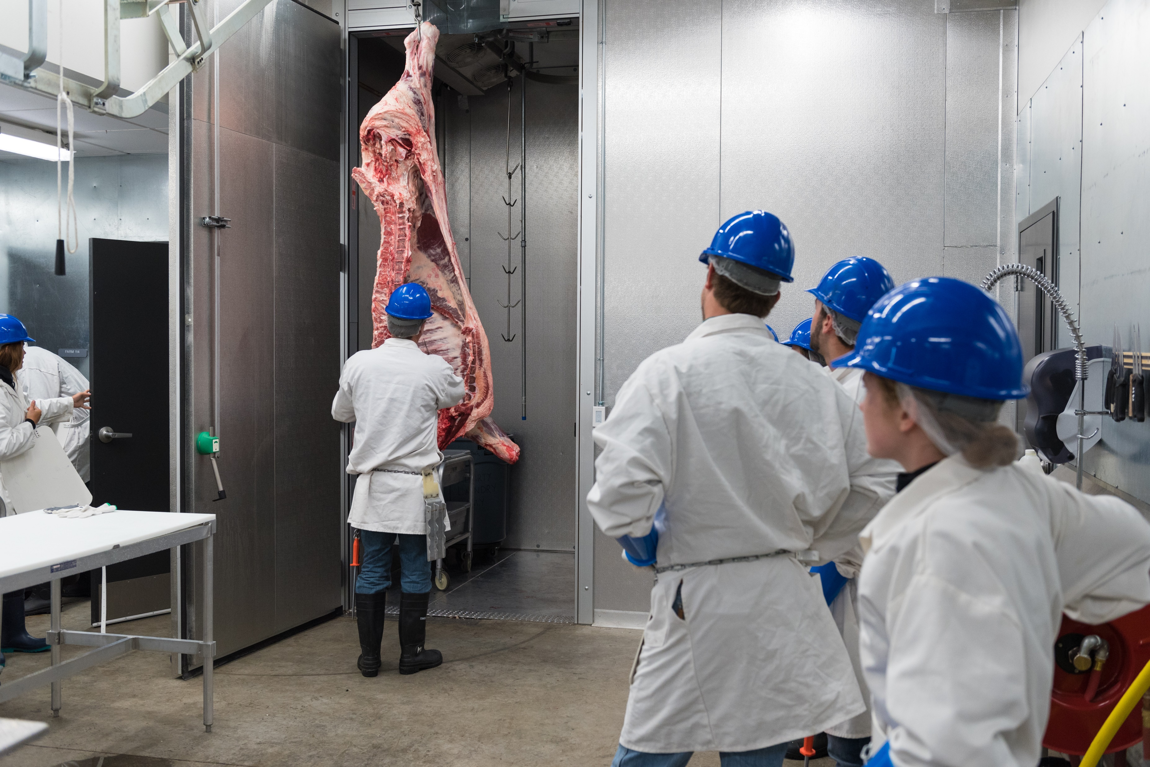
ANS 261 - Intro to Meat Science
In this class students have the opportunity to work on the harvest floor and the cutting floor. Here they get hands-on opportunities to see and learn the process of taking a live animal from harvest to cut and wrapped for our clients. In addition to working in the meat lab, students receive two hours of classroom instruction/week on topics such as HACCP, meat chemistry, safety, industry topics and challenges, sanitation, etc...

Slide 5
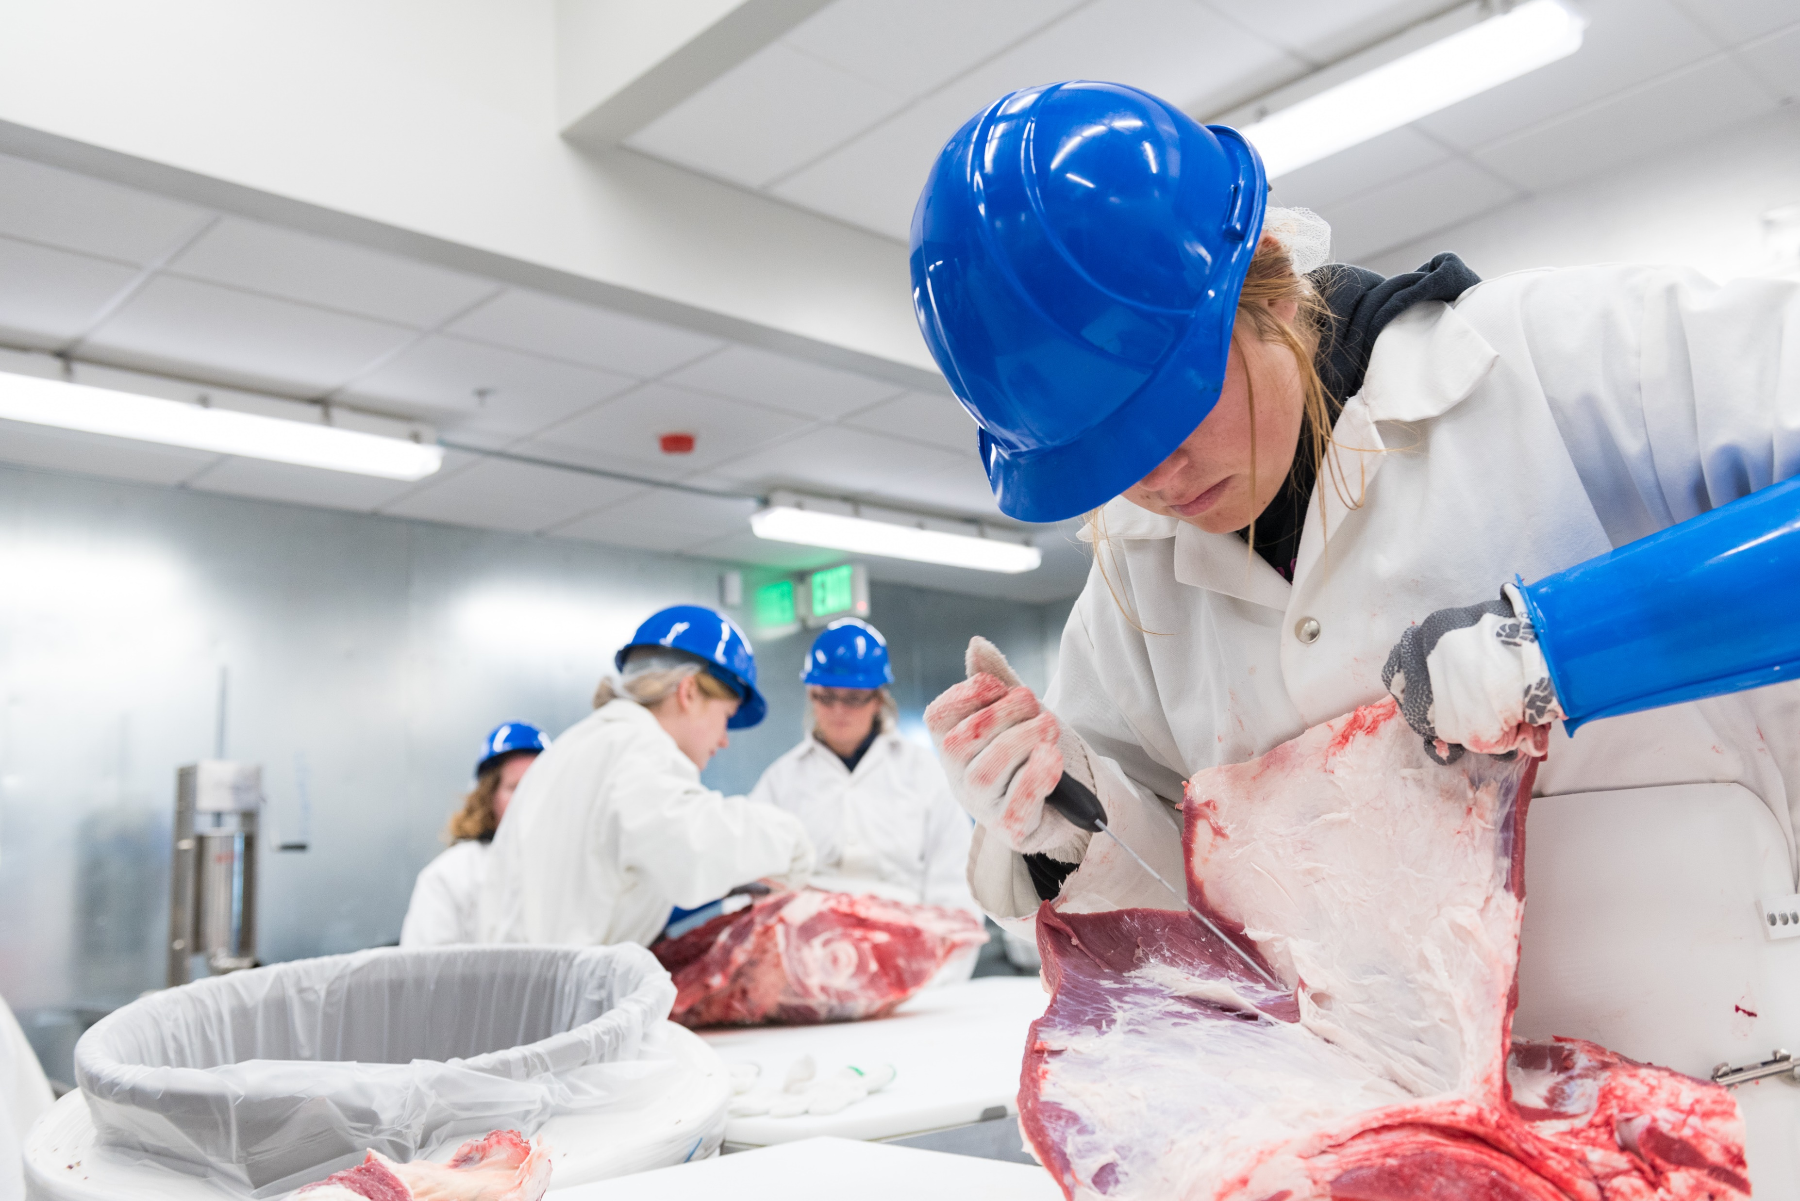
ANS 262- Intro to Processed Meats
In this class students have the opportunity to develop and make value added products such as jerky, snack sticks, sausage, etc. Students receive two hours of classroom instruction/week on topics such as spice and other additive use, cook cycles, casings, HACCP rules, labeling, product evaluation, and other product development.

Slide 6
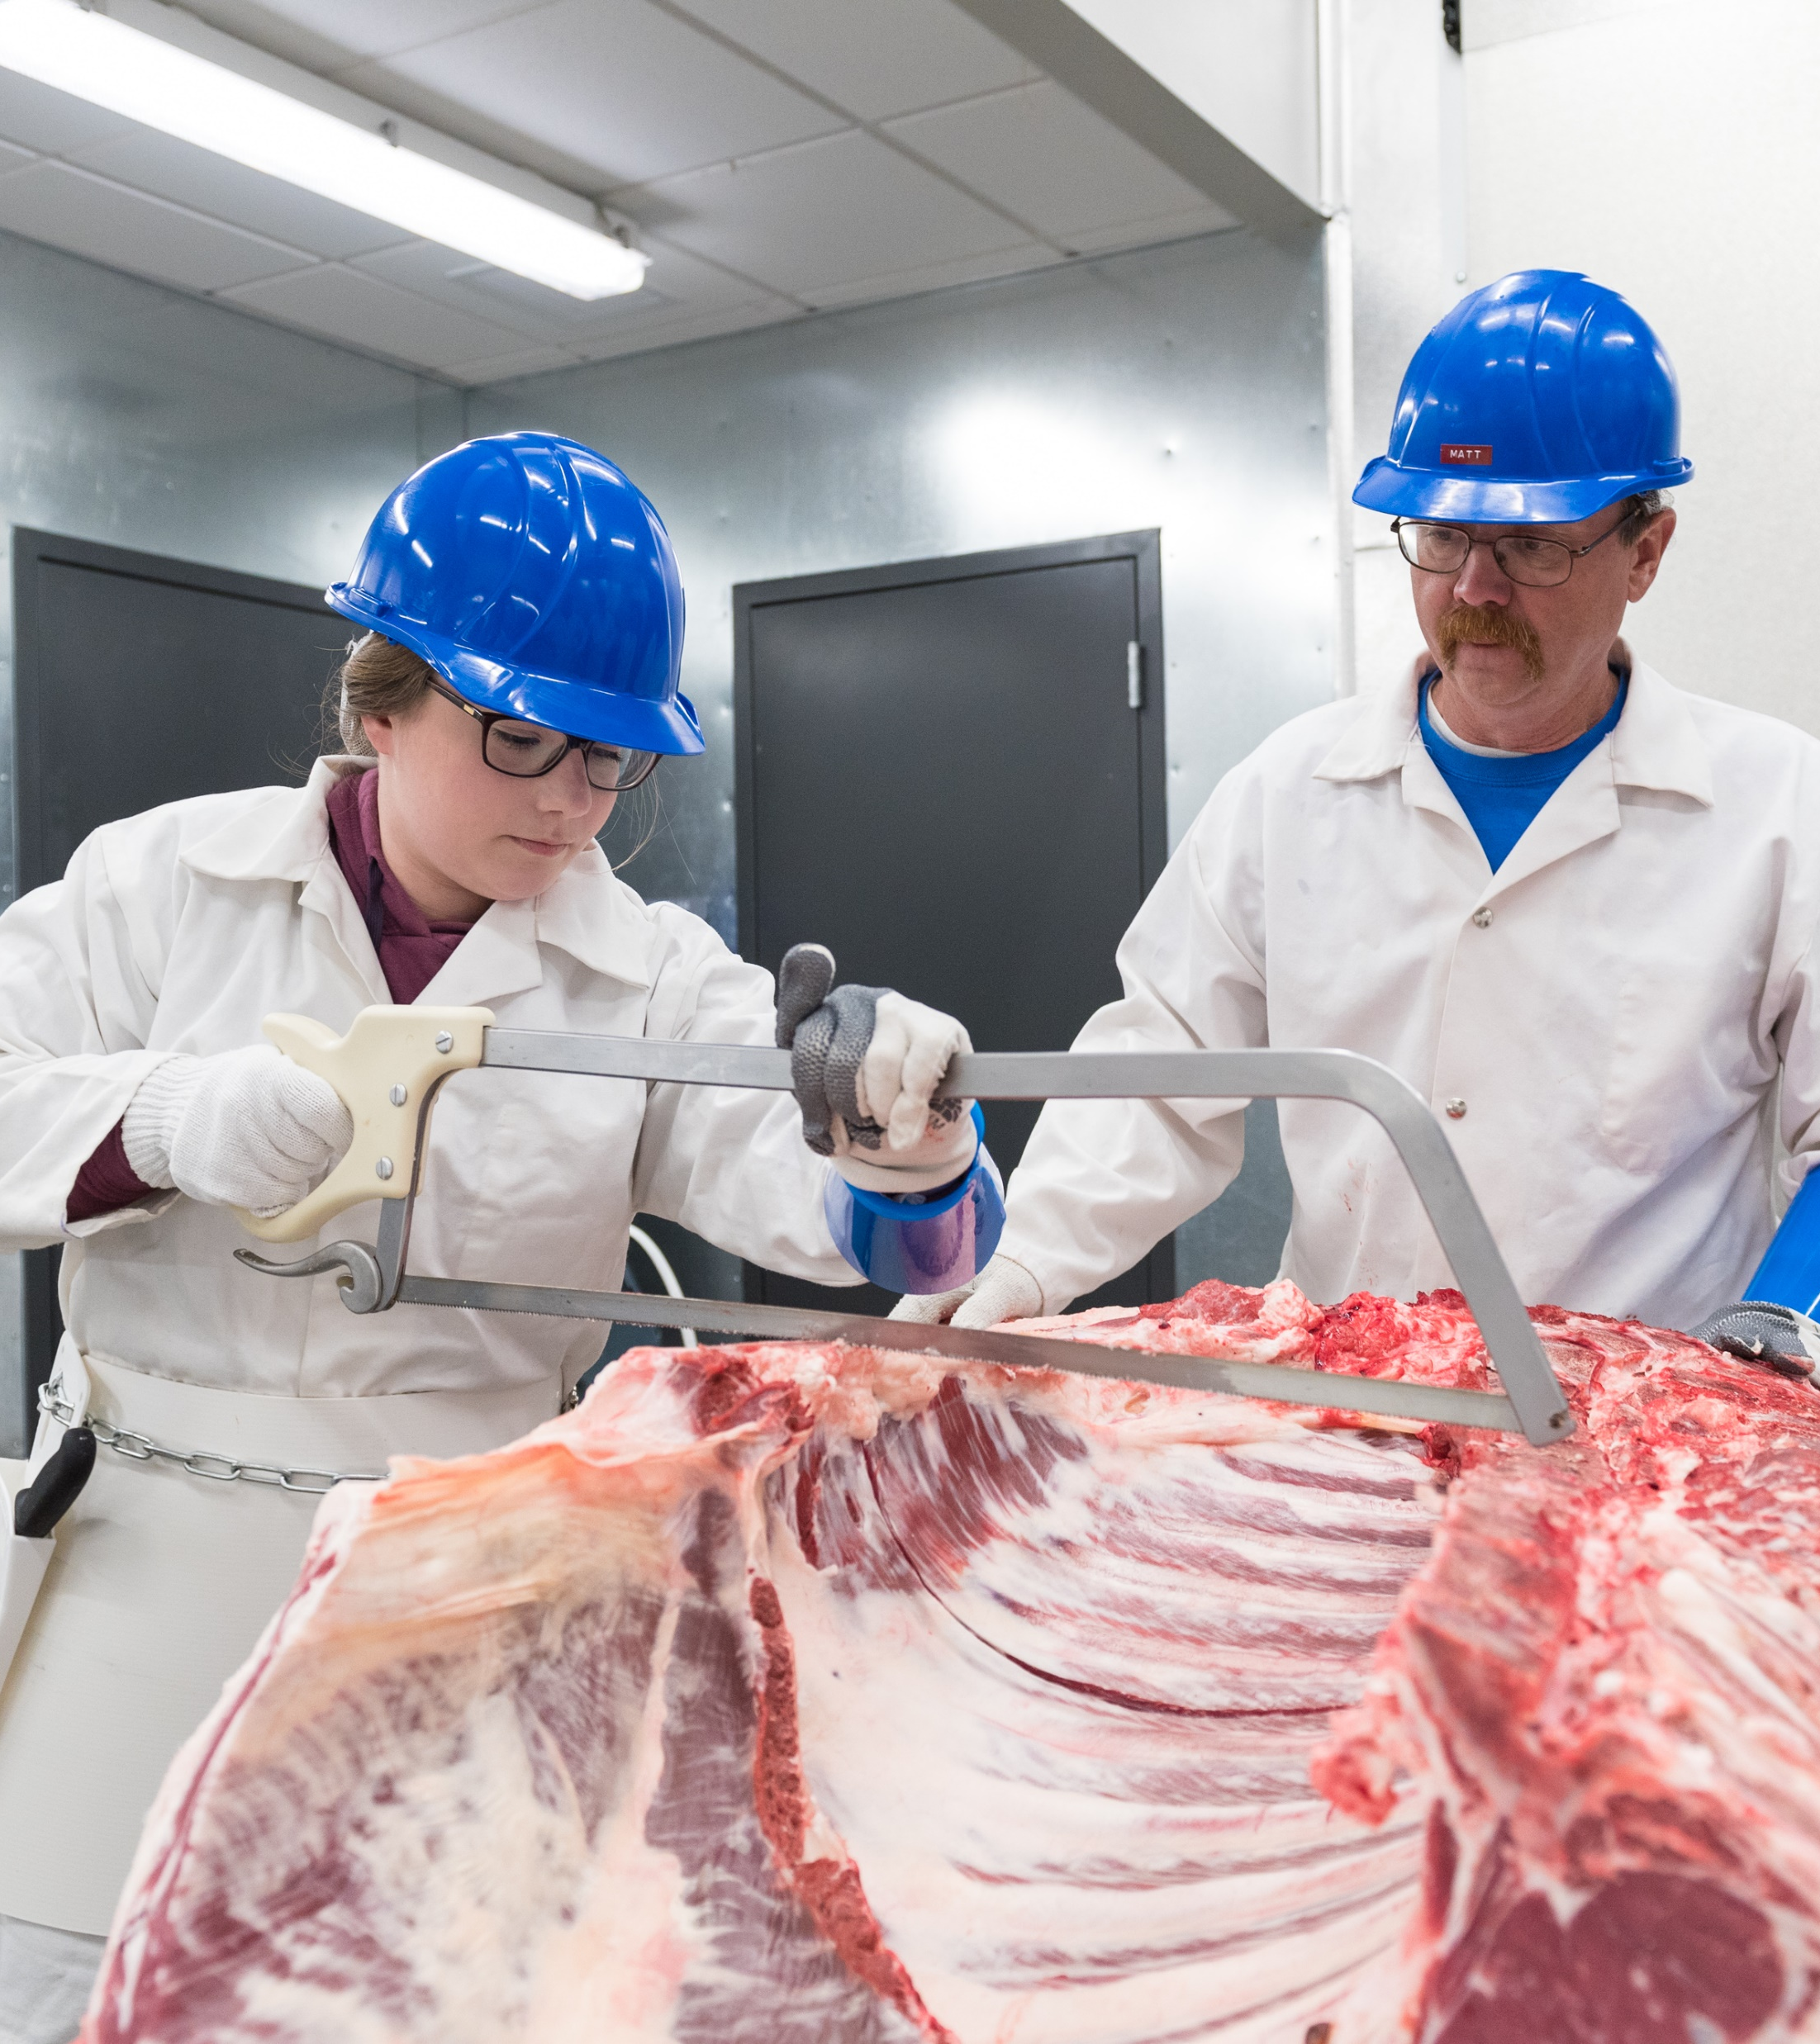
Meat Science Program is Growing!
Put on carcass grading and palatability class for the Oregon Cattlemen's
Working on the Northwest Meat Processors Association apprenticeship program being run through BMCC.
Have submitted a collaborative grant with Oregon State University to update our Meat Science Lab and hire a full-time lab assistant.
We are currently working on a one-year Meat Science Certificate.

