Slide 1
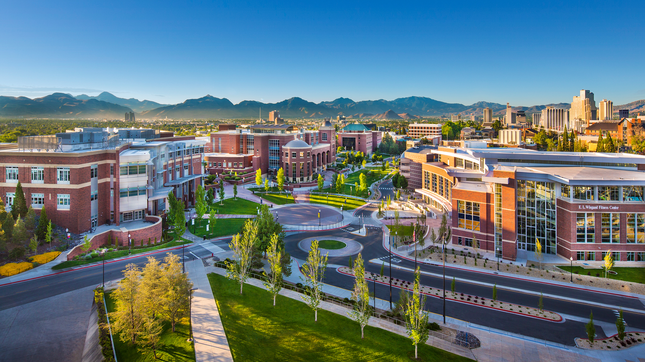

Governance
December 5, 2025
Selena M. Grace, President

Slide 2
Running Meetings
Meeting Structure and Efficiency
Prepare thoroughly before meetings
Follow a clear agenda
Maintain productive meeting dynamics
Public Engagement and Transparency
Welcome public input thoughtfully
Conduct business in public view
Decision-Making Best Practices
Ask the right questions
Balance deliberation with action
Think strategically, act responsibly
Board Culture and Conduct
Model the behavior you expect
Support the board president/chair
Invest in continuous improvement
Notes:
Meeting Structure and Efficiency
Prepare thoroughly before meetings
Board packets should be distributed at least one week in advance
Members should arrive having read materials and prepared questions
Use meeting time for discussion and decisions, not information delivery that could be read beforehand
Follow a clear agenda
Consent agendas can expedite routine business (minutes, regular reports, standard contracts)
Reserve substantive time for strategic issues, policy development, and meaningful discussion
Time-limit agenda items to maintain focus and respect everyone's schedules
Maintain productive meeting dynamics
One person speaks at a time; the chair facilitates equitable participation
Debate ideas respectfully without personal attacks
Disagree during discussion but support board decisions once voted upon
Public Engagement and Transparency
Welcome public input thoughtfully
Establish clear public comment procedures with reasonable time limits
Listen respectfully to all community members, even when you disagree
Explain that the board may not respond immediately but will consider input in deliberations
Conduct business in public view
Reserve closed sessions only for legally permitted topics (personnel, negotiations, litigation)
Make decisions in open session whenever possible
Ensure meeting notices, agendas, and minutes are easily accessible to the public
Decision-Making Best Practices
Ask the right questions
How does this serve our students and mission?
What data supports this decision?
What are the long-term implications for the college?
Have we heard from those most affected by this decision?
Balance deliberation with action
Encourage robust discussion but avoid circular debates
Know when sufficient information exists to make a decision
Revisit decisions only when new information warrants reconsideration
Think strategically, act responsibly
Connect individual decisions to the college's strategic plan
Consider fiscal sustainability and equity implications
Monitor progress on goals through regular dashboards and reports
Board Culture and Conduct
Model the behavior you expect
Demonstrate collegiality, even during disagreements
Maintain confidentiality when required
Avoid conflicts of interest and follow ethical guidelines
Support the board president/chair
The chair facilitates meetings but doesn't have unilateral authority
Work through the chair for agenda items and concerns
Share facilitation challenges privately, not during meetings
Invest in continuous improvement
Regularly assess your board's effectiveness
Participate in governance training and professional development
Stay informed about community college trends and challenges

Slide 3
Red Flags to Avoid
Micromanaging college operations or staff
Making decisions without adequate information or stakeholder input
Discussing board business outside of public meetings (serial meetings)
Allowing a few voices to dominate while others remain silent
Losing sight of student success as the primary mission
Using board position for personal gain or to advance individual agendas

Slide 4






Questions

